Slide 1

CMR TECHNICAL CAMPUS
Department of Computer Science and Engineering
Mini Project Review-01
Rainfall Prediction Using Neural Network Analysis
BATCH NO-14
UNDER THE GUIDANCE OF:
K. SHILPA
(Assistant Professor)
PROJECT COORDINATOR:
Prof K. NARASIMHA RAO
Associate Professor,CSE Department
PRESENTED BY:
B.SAI BHAVANI : 217R5A0510
N.SANDHYA : 207R1A05A4
V.SURAJ KUMAR : 207R1A05B8

Slide 2
Contents:
Abstract
Existing system
Disadvantages of Existing system
Proposed system
Advantages of Proposed system
Hardware and Software requirements
Novelty of the Project
Architecture
Modules
UML Diagrams
Sample code
Results
Conclusion
Future Scope
References
Github Link

Slide 3
ABSTRACT
Artificial Neural Network (ANN)
ARIMA(Auto Regressive Integrated moving Average) is used in predicting the rainfall.
ANN is based on self-adaptive mechanism .
The accurate prediction of rainfall is a major criterion for managing the water resources.
The prediction accuracy error is measured using MAPE and RMSE.

Slide 4
EXISTING SYSTEM
statistical models, such as time series analysis, regression analysis models.
These models rely on historical rainfall data
Other relevant weather factors, such as temperature, humidity, and wind speed, to predict future rainfall patterns.
These models may have limited accuracy
May not be able to capture complex nonlinear relationships between different weather factors.

Slide 5
Disadvantages of Existing system:
Dependency on historical data
Limited accuracy
Limited interpretability
Difficulty in determining optimal network architecture
Computational resources

Slide 6
PROPOSED SYSTEM
The proposed system for rainfall prediction using neural network analysis (ANNs).
ANNs are capable of learning complex nonlinear relationships between input and output variables
Making them ideal for predicting complex weather patterns.
ANNs can also handle large datasets and can continuously learn and adapt to new data, improving their prediction accuracy over time.
In ANNs we use ARIMA model to predict the rainfall more accurately.
The prediction accuracy error is measured using MAPE and RMSE.

Slide 7
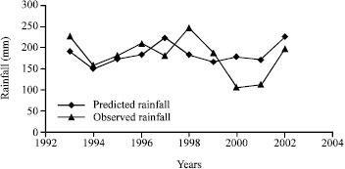
Advantages of Proposed system
Improved decision-making
Faster processing
Improved accuracy
Flexibility
Automated analysis

Slide 8
SYSTEM CONFIGURATION
HARDWARE REQUIREMENTS:
Processor : Intel i3 (or) Higher
RAM : 4GB (or) Higher
HDD : 500 GB
SOFTWARE REQUIREMENTS:
Operating System : Microsoft Windows , Linux or Mac
Coding Language : Python (Jupyter Notebook)

Slide 9
NOVELTY OF PROJECT
Complex relationships between different weather factors, which may not be captured by traditional statistical models.
ARIMA model to predict the rainfall more accurately.
Neural networks are capable of processing large datasets , identifying patterns and trends that may not be obvious to humans.
Leading to more accurate and reliable rainfall predictions.
It can be trained on both historical and real-time data.
This can help with disaster management and mitigation efforts, such as flood control and agricultural planning.

Slide 10
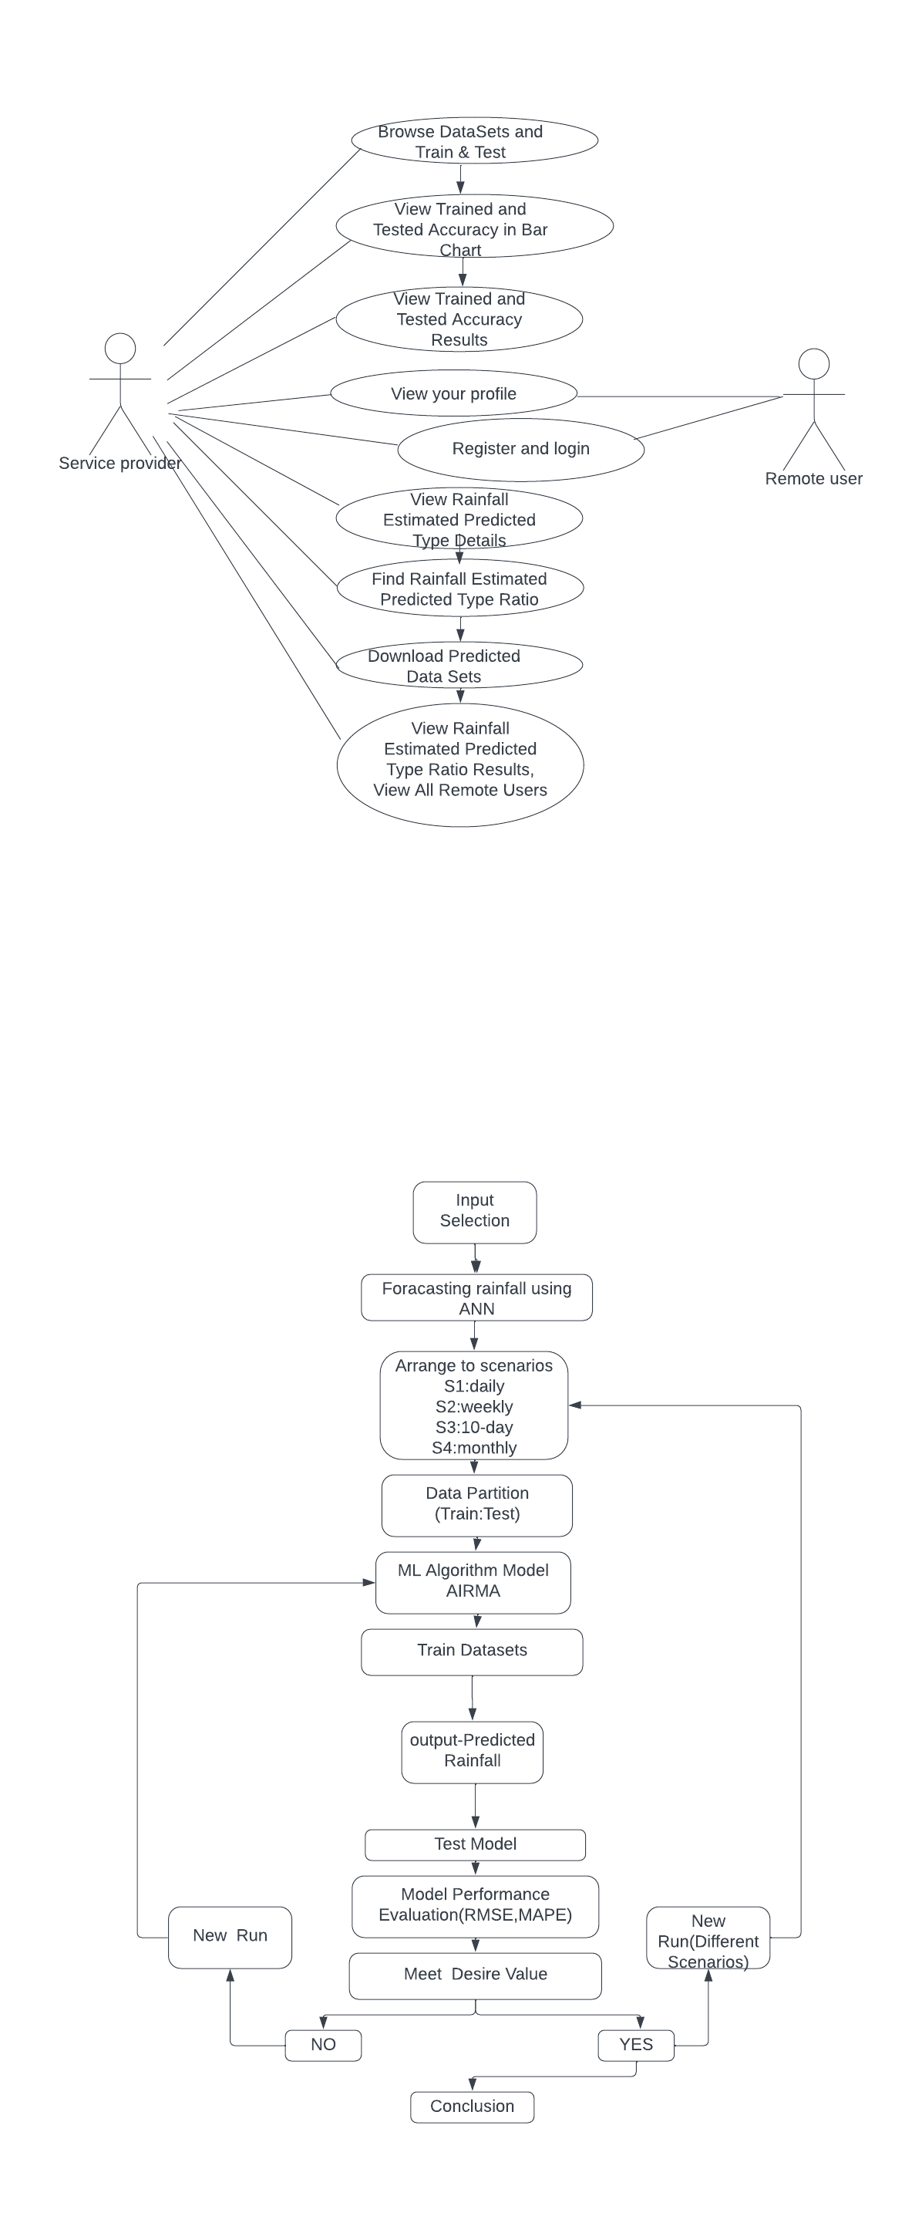
Architecture

Slide 11
Modules
To implement a rainfall prediction project using ARIMA and artificial neural networks (ANN), you would need several modules or components. Here are some essential modules for such a project:
User Module
Interface
System Module

Slide 12
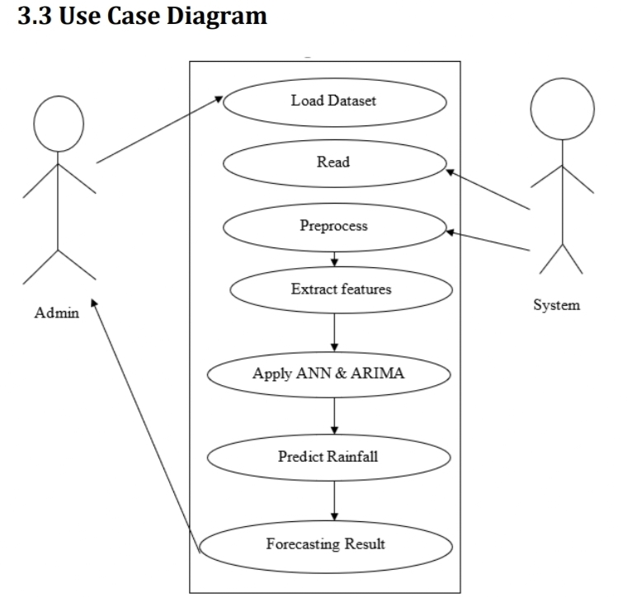
UML Diagrams
Use-case diagram

Slide 13
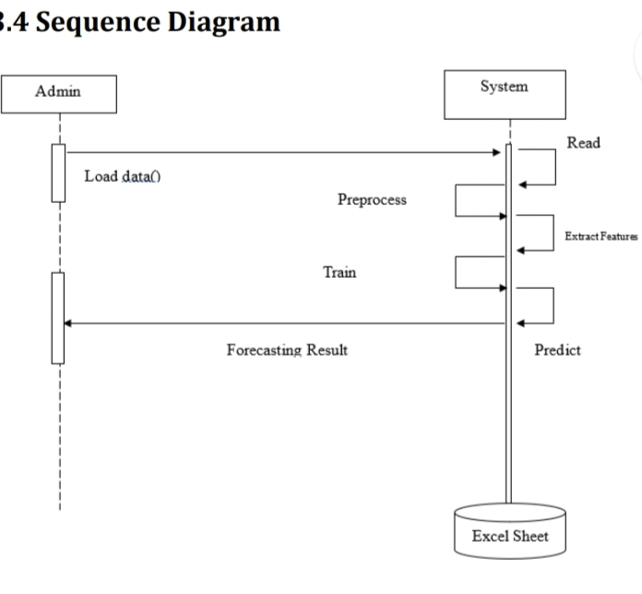
Sequence Diagram

Slide 14
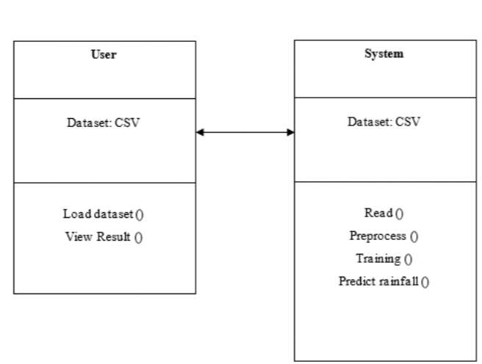
Class diagram

Slide 15
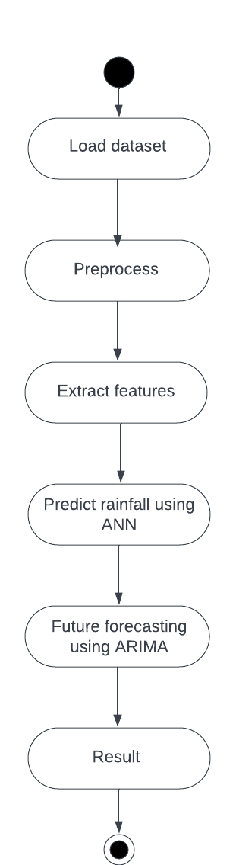
Activity diagram

Slide 16
SAMPLE CODE
*****************IMPORT LIBRARIES***********************
import warnings
warnings.filterwarnings('ignore')
import os
import shutil
import numpy as np
import pandas as pd
import seaborn as sns
import plotly.graph_objs as go
import plotly.offline as py
import matplotlib
import matplotlib.pyplot as plt
#from mpl_toolkits.basemap import Basemap
import matplotlib.pyplot as plt
from matplotlib.patches import Polygon
import matplotlib.patches as mpatches
from matplotlib.collections import PatchCollection
import plotly.figure_factory as ff
from IPython.display import HTML, display
from IPython.core import display as ICD

Slide 17
from plotly.offline import init_notebook_mode, iplot
init_notebook_mode(connected=True)
import Artificial_Neural_Networks as ANN
import ARIMA
import math
from itertools import groupby
%matplotlib inline
from keras.models import Sequential
from keras.layers import Dense
from keras.layers import LSTM
from keras.layers import Flatten
from keras.layers.convolutional import Conv1D
from keras.layers.convolutional import MaxPooling1D
from sklearn.preprocessing import MinMaxScaler
from sklearn.metrics import mean_squared_error
from IPython.display import SVG
from keras.utils.vis_utils import model_to_dot
from importlib import reload
import itertools
*************************USEFUL FUNCTIONS************************
from sklearn.metrics import mean_squared_error

Slide 18
from sklearn.metrics import mean_absolute_error
def mean_absolute_percentage_error(y_true, y_pred):
y_true, y_pred = np.array(y_true), np.array(y_pred)
return np.mean(np.abs((y_true - y_pred) / y_true)) * 100
def root_mean_squared_error(y_true, y_pred):
mse = mean_squared_error(y_true, y_pred)
rmse = np.sqrt(mse)
return rmse
def calculate_performance(y_true, y_pred):
mse = mean_squared_error(y_true, y_pred)
mae = mean_absolute_error(y_true, y_pred)
mape = mean_absolute_percentage_error(y_true, y_pred)
rmse = root_mean_squared_error(y_true, y_pred)
return round(mse, 3), round(mae, 3), round(mape, 3), round(rmse, 3)
********************DATASET*****************
PATH = 'Dataset/rainfall_data_1901_to_2002.xlsx'
data = pd.read_excel(PATH)
**********************PREPROCESS DATA************
data = data.drop(columns='vlookup')
data = data[data['Year'].notnull()]

Slide 19
data['Year'] = data.Year.astype('int')
data.index = range(len(data))
m_data = data[data['State'] == 'Maharashtra']
m_data = m_data.drop(columns='State')
districts = m_data.District.unique()
years = list(range(1901, 2003))
months = data.columns[3:]
year_month = [str(year) + '_' + month for year in years for month in months]
dates = pd.date_range(start='1901-01', freq='MS', periods=len(years)*12)
maharashtra_data = pd.DataFrame({'Year_Month': year_month})
maharashtra_data['Date'] = dates
maharashtra_data[['Year', 'Month']] = maharashtra_data['Year_Month'].str.split('_', n=1, expand=True)
maharashtra_data = maharashtra_data.drop(columns=['Year_Month’])
for district in districts:
df = m_data[m_data.District == district].drop(columns=['District', 'Year'])
df = df.to_numpy().reshape((len(years) * len(months), 1))[:,0]
maharashtra_data[district] = df
maharashtra_data.head()
m_data = maharashtra_data.copy()

Slide 20
districts_of_interest = ['Kolhapur', 'Latur']
months_of_interest = ['Jun', 'Jul', 'Aug', 'Sep']
rainfall_season_data = m_data[m_data.Month.isin(months_of_interest)]
rainfall_season_data = rainfall_season_data[['Date', 'Year', 'Month'] + districts_of_interest]
rainfall_season_data.head()
****************PARAMETERS*********************
future_steps = 10
STORAGE_FOLDER = 'State_predictions/'
if not os.path.exists(STORAGE_FOLDER):
os.makedirs(STORAGE_FOLDER)
parameters_WNN = [[3,6,8,10,12], [4,5,6], [1], [300], [20], [future_steps]]
parameters_WAANN = [[12], [3,4,5,6], [300], [20], [future_steps]]
#parameters_WAANN = [[12], [3], [50], [20], [future_steps]]
******************RUN,COMPARE AND SAVE OUTPUT******************
for district in districts_of_interest:
temp_data = rainfall_season_data[['Date', 'Year', 'Month', district]]
for month in months_of_interest:
df = temp_data[temp_data.Month == month]
df.index = range(len(df))

Slide 21
df = df[['Date', district]]
dates = df.Date
rainfall_data = pd.DataFrame({'Precipitation': df[district][:-1*future_steps]})
rainfall_data.index = dates[:-1*future_steps]
test_rainfall_data = pd.DataFrame({'Precipitation': df[district][-1*future_steps:]})
test_rainfall_data.index = dates[-1*future_steps:]
scaler = MinMaxScaler(feature_range=(0, 1))
scaler.fit(rainfall_data)
output_folder = STORAGE_FOLDER + district + '_' + month + '/'
if not os.path.exists(output_folder):
os.makedirs(output_folder)
ANN = reload(ANN)
RMSE_info = ANN.compare_ANN_methods(rainfall_data, test_rainfall_data, scaler,
parameters_WNN,parameters_WNN, parameters_WAANN, parameters_LSTM, future_steps, output_folder)
ANN = reload(ANN)
ANN.save_RMSE_info(output_folder, RMSE_info)
Since we used 300 epochs but by default we need to use 1000epochs for Wavelet Neural Network for better accuracy, due to lack of Memory

Slide 22
for district in districts_of_interest:
temp_data = rainfall_season_data[['Date', 'Year', 'Month', district]]
for month in months_of_interest:
df = temp_data[temp_data.Month == month]
df.index = range(len(df))
df = df[['Date', district]]
dates = df.Date
rainfall_data = pd.DataFrame({'Precipitation': df[district][:-1*future_steps]})
rainfall_data.index = dates[:-1*future_steps]
test_rainfall_data = pd.DataFrame({'Precipitation': df[district][-1*future_steps:]})
test_rainfall_data.index = dates[-1*future_steps:]
scaler = MinMaxScaler(feature_range=(0, 1))
scaler.fit(rainfall_data)
output_folder = STORAGE_FOLDER + district + '_' + month + '/'
print(output_folder)
if not os.path.exists(output_folder):
os.makedirs(output_folder)
ARIMA = reload(ARIMA)
forecasted_values = ARIMA.ARIMA(rainfall_data, output_folder, future_steps)
errors = test_rainfall_data.Precipitation - forecasted_values

Slide 23
ARIMA_actual_forecasted = pd.DataFrame({'Actual': test_rainfall_data.Precipitation,
'Forecasted': forecasted_values,
'Errors': errors}
ARIMA_actual_forecasted.to_csv(output_folder + '/' + 'ARIMA_actual_and_forecasted.csv’)
plt.figure(figsize=(10,5))
plt.plot(ARIMA_actual_forecasted.drop(columns=['Actual', 'Forecasted']), color='blue', label='Error: Actual - Forecasted’)
plt.xlabel('Year')
plt.ylabel('Error')
plt.legend(loc='best')
plt.title('ARIMA - Error: Actual - Forecasted')
plt.savefig(output_folder + 'ARIMA_error_plot' + '.png')
y_true = test_rainfall_data.ix[:int(future_steps)]
plt.figure(figsize=(10,5))
plt.plot(y_true, color='green', label='Actual values')
plt.plot(forecasted_values, color='red', label='Forecasted values')
plt.xlabel('Year’)
plt.ylabel('Monthly mean Precipitation')
plt.legend(loc='best')

Slide 24
plt.title('ARIMA - Comaprison: Actual vs Forecasted')
plt.savefig(output_folder + 'ARIMA_best_forecast' + '.png')
mse, mae, mape, rmse = calculate_performance(y_true, forecasted_values)
RMSE_score = pd.read_csv(output_folder + 'RMSE_score.csv')
best_method = RMSE_score.iloc[RMSE_score.RMSE.argmin]['Unnamed: 0']
RMSE_score = RMSE_score.append({'Unnamed: 0': 'ARIMA', 'RMSE': str(rmse)}, ignore_index=True)
RMSE_score.RMSE = RMSE_score.RMSE.astype('float')
current_best_method = RMSE_score.iloc[RMSE_score.RMSE.argmin]['Unnamed: 0']
RMSE_score = RMSE_score.set_index('Unnamed: 0')
RMSE_score.to_csv(output_folder + 'RMSE_score.csv')
axis = RMSE_score.plot(kind='bar', figsize=(10,5), rot=0, title='RMSE scores')
axis.set_xlabel('Method name')
for p in axis.patches:
axis.annotate(np.round(p.get_height(),decimals=2),
(p.get_x()+p.get_width()/2., p.get_height()),
ha='center', va='center', xytext=(0, 10),
textcoords='offset points', fontsize=14, color='black’)

Slide 25
fig = axis.get_figure()
fig.savefig(output_folder + 'RMSE.png')
if current_best_method == 'ARIMA':
y_true = test_rainfall_data.ix[:int(future_steps)]
plt.figure(figsize=(10,5))
plt.plot(y_true, color='green', label='Actual values')
plt.plot(forecasted_values, color='red', label='Forecasted values')
plt.xlabel('Year’)
plt.ylabel('Monthly mean Precipitation')
plt.legend(loc='best')
plt.title('Best of all: ARIMA - Comaprison: Actual vs Forecasted')
plt.savefig(output_folder + 'BEST_FORECAST_ARIMA' + '.png')
os.remove(output_folder + 'BEST_FORECAST_' + best_method + '.png')

Slide 26
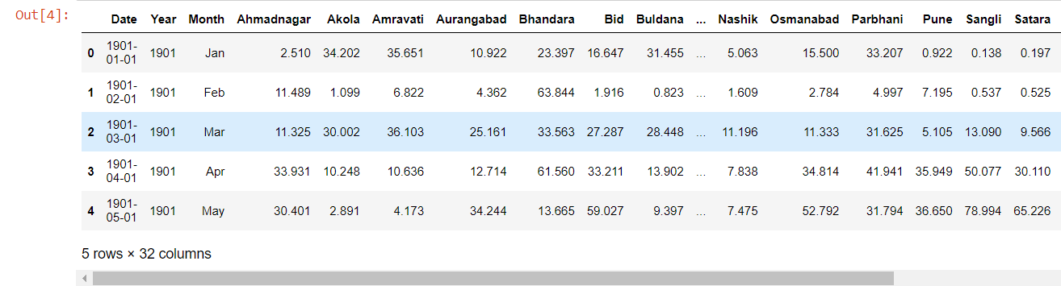
RESULTS

Slide 27
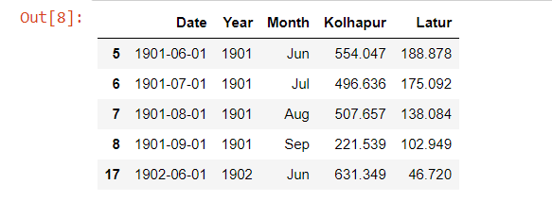
RESULTS

Slide 28
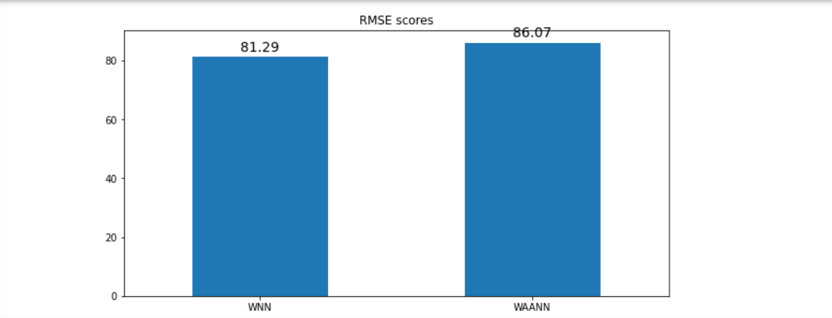
RESULTS

Slide 29
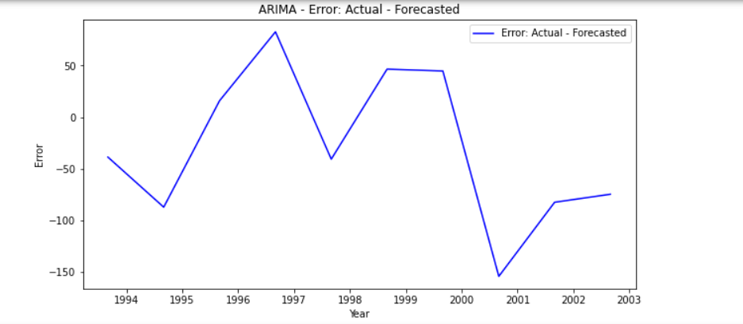
RESULTS

Slide 30
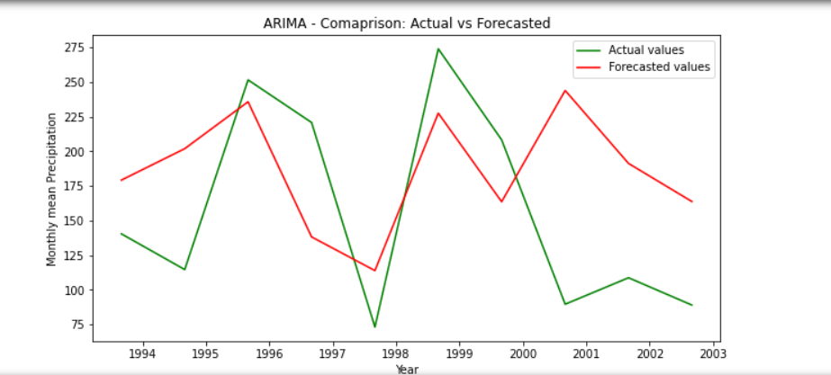
RESULTS

Slide 31
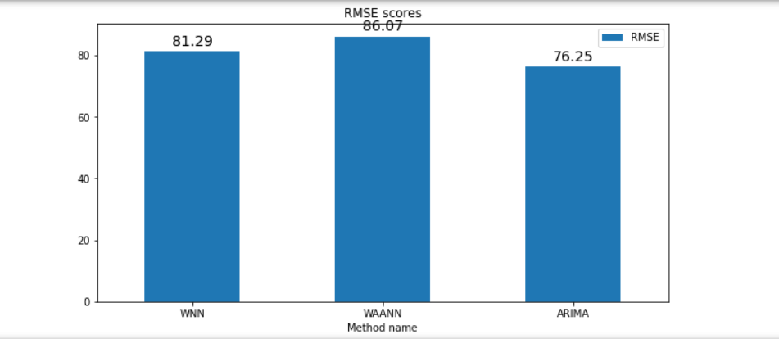
RESULTS

Slide 32
CONCLUSION
In existing system the traditional methods are used to predict where as in proposed system, machine learning algorithms such as ANN is used.
In ANN’s ,ARIMA model is used to predict the rainfall more accurately .
RMSE(Root mean square error)values of existing system is 86.07 and the value of proposed system (ARIMA)is 76.25 which gives us an accurate value.
The model was able to provide better results than other algorithms
Provide accurate predictions for planning in agriculture and other industries.

Slide 33
FUTURE SCOPE
Improved Accuracy and Precision: Advances in deep learning can enhance rainfall prediction accuracy.
High-Resolution Spatial Prediction: ANNs enable localized forecasts, vital for flood prediction and urban planning.
Climate Change Adaptation: ANNs model climate change's impact on rainfall patterns.
User-friendly Interfaces: Accessible software for diverse users.
Customized Applications: Tailored ANN models for specific uses.

Slide 34
REFERENCES
Rainfall dataset5of our country is5taken from kaggle website https://www.kaggle.com/rajanand/rainfall-in-india
Mosavi, A., Ozturk, P., & Chau, K. W. (2018). Flood prediction using5machine learning5models: Literature review. Water (Switzerland), 10(11). https://doi.org/10.3390/w10111536
Janani, B; Sebastian, P. (2014). Analysis on the weather forecasting5and techniques. International Journal5of Advanced Research in Computer Engineering & Technology, 3(1), 59–61.
Chaudhari, M. S., & Choudhari, N. K. (2017). Open Access Study of5Various Rainfall Estimation & Prediction Techniques5Using Data Mining. American Journal of Engineering Research (AJER), 7, 137– 139. http://www.ajer.org/papers/v6(07)/Q060713713 9.pdf
Shi, X., Chen, Z., & Wang, H. (2015). Convolutional LSTM Network. Nips, 2–3. https://doi.org/[]
Wahyuni, E. G.Fauzan, L. M.F.Abriyani, F.Muchlis, N. F., & Ulfa, M. (2018). Rainfall prediction5with backpropagation method.5Journal of Physics: ConferenceSeries,983(1).

Slide 35
GITHUB LINK
https://github.com/Suraj5566/Rainfall-prediction-using-neural-network-analysis

Slide 36
THANK YOU

